Slide 1
Functions in Python
By Dr Shantanu Pathak

Slide 2
Size of Software programs
1000 line of code is required for small applications
1000,000 (Million) Lines of codes are used in smart phones or operating systems
Python has more than 100,000+ libraries!!
Softwares are HUGE!

Slide 3
Modular Programming
Huge programs need to be divided into logical subparts and small units
These small units should work alone as well as should work when together with other units, like small parts of big machine
Ex.
Gmail App -> check email, download email, send email, show email , etc
all units work when together as well as individually they work
Such Modular programming is achieved commonly using functions, classes, etc.

Slide 4
Functions
Function is group of instructions put together, which can be called (executed) many times whenever required
Ex. print() is a function with group of instructions to print given message on the display screen
Functions are created when same steps needs to be repeated many times
Small functions make code readable and understandable

Slide 5
Functions General Overview
Parts of function syntax
Name, Parameters, Return Value
Flow of execution
Function definition
Function call -> call after definition ONLY
Where control goes after function?
Parameters
What are parameters?
What is need of parameters ?
How parameters are passed (by value , by ref)
Memory allocation
For code
For parameters and variables
Return value
Always a single value
Why to return a value?

Slide 6
Functions in Python

Slide 7
Part 1

Slide 8
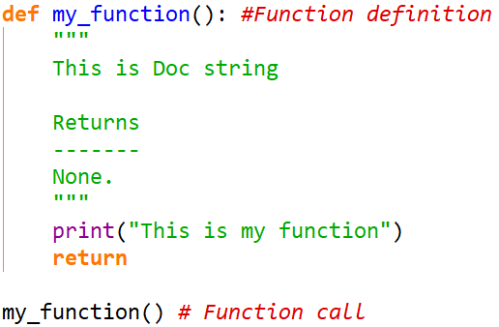
Functions
Syntax
Observe the Indentation
Example: function for addition of two numbers

Slide 9
Functions
Every function is an object of class function
Every function is first class object in python (means just like any other variable) Ref: https://en.wikipedia.org/wiki/First-class_citizen
We can create
List of functions
set of functions
Dictionary which uses function objects inside
Copy by Assignment of function (old deep copy)
A function object can be assigned another object reference
Ex. Fun1 = my_function
Functions can be passed as arguments to other functions and can be returned from a function
NOTE:
Don’t use variable name same as function name it will change the original function object, and there will be Error when you try to call the function
Its Good practice to define all functions in top region of the program and then call them or use is later part. Function definitions within code make code less readable.

Slide 10
Exercise
WAP function to multiply all odd numbers from 1 to 100 and print the result
WAP to create function to calculate factorial and print it

Slide 11
return Statement
Return single value
Ex. input()
WAP for Addition, Multiplication functions
Return multiple values
Python’s trick to return multiple values
Ex. WAP to have maxmin function to return max and min from a list
Return no value
Ex. print()
No return statement

Slide 12
Recursive Function
Function calls itself
Just like a loop
IMP:: Breaking condition
Infinite loop if no breaking condition
Exercise: Print hello 3 times using recursive function
Recursive function for factorial calculation

Slide 13
Function Parameters & Arguments
Parameters:
Are given in the function definition
Arguments:
Are actual values sent to the function
Name parameter and argument are used interchangeably in documentation
Arguments are passed by assignment to the function
Argument passing has same behavior as doing assignment operation ( Ex. b=a)
Value of the object reference of argument is given to the parameter of the function
Graphic Example: how values are passed?

Slide 14
Function Parameters & Arguments
Behavior of Mutable vs Immutable Arguments
Mutable Arguments:
Because copy by assignment is passed any changes inside function will reflect to the original object
But, If new object is assigned, then it will not affect original object
Immutable Arguments:
Because copy by assignment is passed when value is changed new object reference is created locally so, original value is not affected

Slide 15
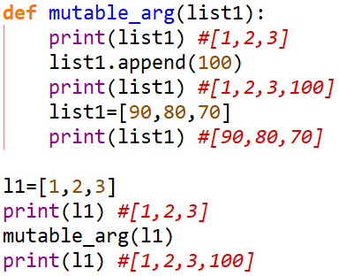
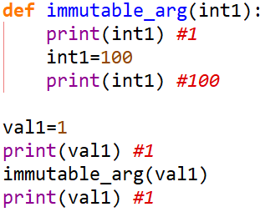
Function Parameters & Arguments
Behavior of Mutable vs Immutable Arguments
Example: Observe the changes!

Slide 16
Function Parameters & Arguments
Types of Arguments
Positional Only Parameters
Keyword Only Parameters
Standard Parameters
Default Argument Values
Arbitrary length positional Arguments
Arbitrary Length keyword Arguments

Slide 17
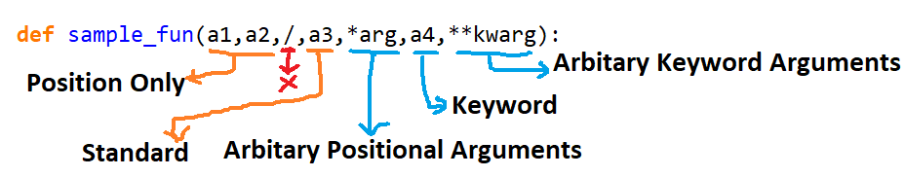
Function Parameters & Arguments

Slide 18
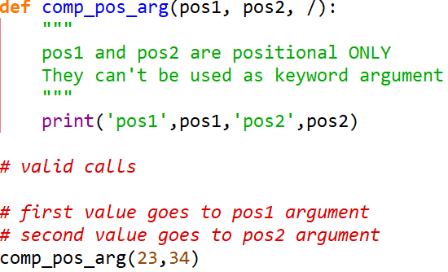
Positional Only Arguments
Arguments can be passed ONLY by position
Calling the function will assign the value to Arguments in sequence
PVM understands all arguments before ‘/’ as position ONLY

Slide 19
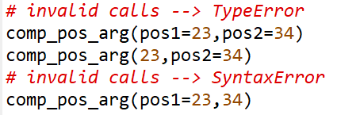
Positional Only Arguments

Slide 20
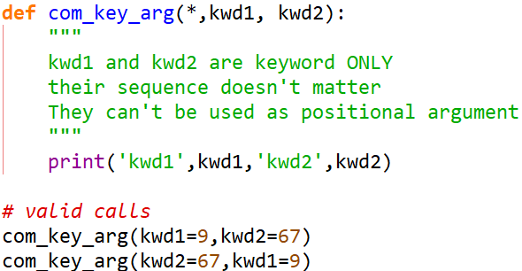
Keyword Only Arguments
Arguments SHOULD be passed as their name=value format
Sending ONLY value will give Error
PVM understand all arguments after ‘*’ as Keyword ONLY

Slide 21
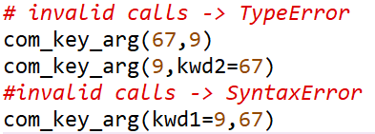
Keyword Only Arguments

Slide 22
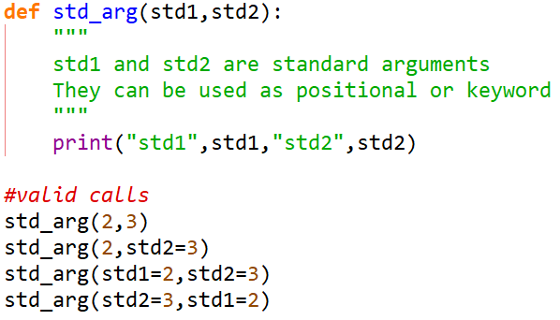
Standard Arguments
They can be used as positional as well as keyword arguments
NOTE: Using positional arguments after keyword arguments is SyntaxError

Slide 23
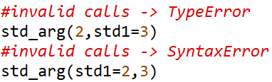
Standard Arguments

Slide 24
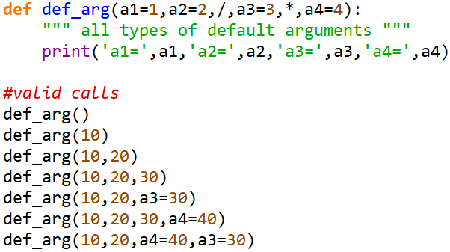
Default Arguments
All types of arguments can be given default values
Non-default argument after default is not allowed
This makes calls to function, flexible

Slide 25
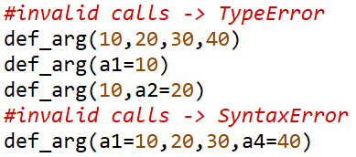
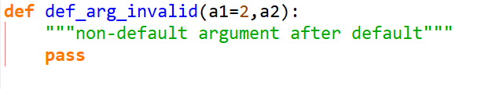
Default Arguments
Invalid syntax for default arguments ->
NOTE: Mutable value as default value will lead to having same object reference in all function calls!

Slide 26
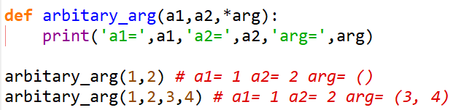
Arbitrary length positional Arguments
Any number of positional arguments are allowed to be sent to such function
Ex. print()
‘*arg’ argument is used for this purpose
All extra positional values are taken as a tuple in ‘arg’ variable
NOTE: name ‘arg’ is just variable name it can be any valid variable name

Slide 27
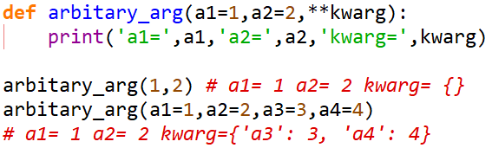
Arbitrary length keyword Arguments
Any number of keyword arguments are allowed to be sent to such function
‘**kwarg’ argument is used for this purpose
All extra keyword values are taken as a dictionary in ‘kwarg’ variable
NOTE: name ‘kwarg’ is just variable name it can be any valid variable name

